Slide 1
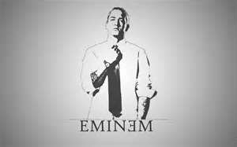
Marshal Mathers III
“IM SHADY!”
By: Eric R. Curtis
EMIN
M
E
Notes:
Eminem’s given name Marshal Mathers III after his father Marshal Mathers Jr.

Slide 2
Biography
Notes:
This section describes the personal background of producer Eminem.

Slide 3
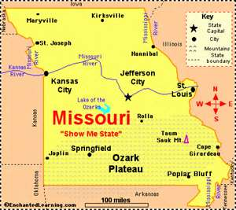
Biography
Youth:
Born on October 17, 1972
Born in St. Joseph, Missouri
Raised by Mother Deborah
Father (Marshal Mathers Jr.) ran out on them
Moved to Detroit, Michigan
Notes:
Eminem is now 41 years old! Marshal had a tough childhood his father ran out on the family, leaving mother Debra who had a very hard time keeping a stable job to take care of the young family. This ment the family would need to move multiple times, ending up in Detroit Michigan.

Slide 4
EMINEM’S NICKNAMES
Marshal Mathers
Slim Shady
Eminem from initials (M&M)
B-Rabbit (From Motion Picture “8 Mile”)
Notes:
Eminem has many nicknames Slim Shady was created when he was using the restroom and had a writers block and thought of all the words that rhyme with it. Eminem came from his own initials. B-Rabbit was his nickname in the motion picture 8 Mile.

Slide 5
EMINEM’S FAMILY
Mother = Deborah
Father = Marshal Mather Jr.
Ex-Wife / High School Sweetheart = Kim Scott
Daughter = Hailie Jade Scott.
Notes:
Marshal Mathers is named after his deadbeat dad and was raised by Mother Deborah who had a tough time keeping a job. Eminem married his high school sweetheart and had child named Hailie Jade Scott. (married Kim twice and divorced twice)

Slide 6
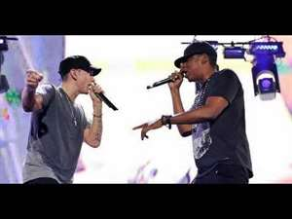
Biography Continued…
Early Rap Career:
Dropped out of High School in the 9th Grade
Worked odd jobs around Detroit
In-between graveyard shifts would participate in rap battles
Discovered by NWA member Dr. Dre (Andre Young)
First solo album was released February 23, 1999
Notes:
Eminem failed the 9th grade. Finally, dropping out of High School he would work different jobs around Detroit. Not graduating from High school made it tough for Eminem to fond a good job. For extra money Eminem would participate in rap battles. During the rap battles Andre Young (Dr. Dre) discovered Eminem and signed him to Aftermath/Interscope records.

Slide 7
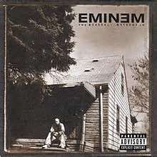
Solo Albums
Rap Albums:
- Slim Shady LP
(Released: February 23, 1999)
- The Marshal Mathers LP
(Released: May 23, 2000)
- The Eminem Show*
(Released: May 26, 2002)
- Encore*
(Released: November 16, 2004)
- Relapse*
(Released: May 15, 2009)
- Recovery*
(Released: June 18, 2010)
* Co-produced albums under record company “Shady Records”
Notes:
Eminem has released six solo albums, four of which he produced. During his hiatus after Encore due to prescription drug addiction. This is why it took five years between albums.

Slide 8
Other Rap Albums Produced By Eminem
Xzibit – Restless (2001)
Jay-Z – Blueprint (2001)
D12 – Devil’s Night (2001)
Nas – God’s Son (2002)
50 Cent – Get Rich Or Die Tryin’ (2003)
2Pac – Tupac: Resurrection (2003)
G-Unit – Beg For Mercy (2003)
Obie Trice – Cheers (2003)
2Pac – Loyal To The Game (2004)
D12 – D12 World (2004)
50 Cent – The Massacre (2005)
The Notorious B.I.G. – Duets: The Final Chapter (2005)
The Game – The Documentary (2005)
T.I. – T.I. Vs. T.I.P. (2007)
Notes:
Eminem has helped produce these famous Rap artists.

Slide 9
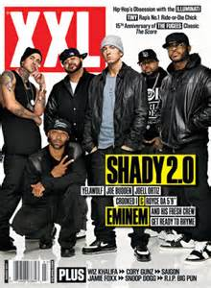
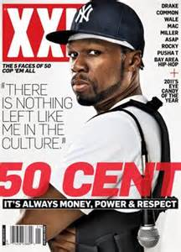
Rap Artist’s Linked To Eminem
Dr. Dre
D12
Obie Trice
50 Cent
Royce 5’9
Notes:
Again, Dr. Dre discovered Eminem. D12 is Eminem’s group he produces as well as raps in. Obie Trice & Cent is a rap artist that were discovered by Eminem and both rap under Eminem’s record label “Shady Records.”

Slide 10
Composition History & Listening Guide
Notes:
Next section is about three songs selected by myself as well as the listening guide.

Slide 11
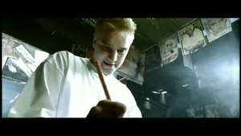
Stan (6:43)
Released song on the record “Marshal Mathers LP”, this album was released May 23, 2000 and published by Insterscope/Aftermath records. This song was co-produced alongside Dido (Florian Cloud de Bounevialle O’Malley Armstrong), who is a London born singer/songwriter and performer. Dido sings the chorus of this song. This song was also performed at the 2001 Grammy’s with legendary performer Elton John who sang the chorus in place of Dido.
STAN (FAN)
EMINEM (STAR)
Notes:
This song trades versus of Marshal Mathers speaking as a fan by the name of Stan who writes as Eminem’s biggest fan, then Eminem writes Stan back. This song is controversial because at the end of the song Stan records a tape while kidnapping his pregnant wife and putting her in the truck and driving drunk over a bridge to both of their death, his last words being “how am I going to send this s*** out.” Eminem then sends a letter back to Stan, while writing the letter back to Stan he recalls a man in the news that drove his pregnant wife off a bridge then realizing it was Stan. In the music video it shows Eminem writing the letter back to Stan by a window, when he realizes the man in the news is Stan lightning strikes and you see Stan’s reflection looking at him through the window as a ghost.

Slide 12
Stan Listening Guide 1
(0:00) Track starts out with raindrops falling in a storm,
(0:02) Before chorus begins music is cut just silence is heard. Chorus begins with Dido singing with no background instruments.
(0:02 – 0:21) Rhythm begins with bass blaring.
(0:22) Lightning strikes fast before silence again.
(0:25) Melody begins as well in sync with the rhythm with beats measured ¾.
(0:49) Verse one begins as Eminem is playing the part of Stan who is excited to write his favorite rapper. Tempo of the song is shown.
(1:36) Chorus begins.
(1:41) Tone is now higher in regards to the next verse being sung.
(2:00) Stan in verse two is becoming a little tense not being able to hear back from Eminem.
Notes:
Point out Melody and how it is measured. Also point out the tone change right before the second verse begins.

Slide 13
Stan Listening Guide 2
(2:25 – 2:27) Bass was dropped during dramatic lyric.
(2:50) Hook being introduced to the song w/ performer Dido singing “It’s not so bad, not so bad.”
(3:12) Verse two ends quickly, being interrupted by the chorus.
(3:13) Chorus begins.
(3:36) Verse three starts with the pitch being lowered because Stan still hasn’t received a letter from Eminem.
(3:58) Beat stops for two seconds.
(4:32) Women screaming.
(4:34 – 4:49) Sound effects of car tires squealing and splashing.
(5:00) Chorus begins.
(5:24) Verse four begins with Eminem playing the artist finally getting around to writing fan Stan.
(6:00) Form in this song stays consistent throughout.
(6:36) Rhythm stops after Eminem realizes Stan was the man in the news he heard and says the word “Damn.”
Notes:
Point out the hook of the song being introduced, as well as the third verse starting with a lower pitch.

Slide 14
Cleaning Out My Closet (4:57)
This was the fourth track on his third solo album entitled “The Eminem Show.” This album was released May 22, 2002. This song explains his anger towards his mother Deborah Mathers, Ex-wife Kim and his troubled childhood.
Notes:
The first verse is Eminem answering his music critics explaining his troubled past. The second verse is to his father who deserted him while he was young and how he wouldn’t do that to his daughter. And the final verse was aimed towards his no Ex-wife who was caught kissing a club bouncer getting him in trouble because Marshal retaliated.

Slide 15
Cleaning Out My Closet Listening Guide 1
(0:00 – 0:07) Introduction is played tempo is soft then comes in more loudly.
(0:08) Melody starts with Eminem complaining about the sound in his earphones.
(0:09) Drums making the melody of the song with a mixed beat.
(0:23) Piano going over four to five key repeating sequence of same keys.
(0:33) Verse one begins.
(0:45) The tempo is slowing down.
(1:02) Harmony fading as chorus is about to begin.
(1:12) Chorus begins. (1:13) Violins are introduced into the chorus making the melody more frigid.
(1:24) Chorus is repeated, Violins tempo begins to speed up.
(1:38) Verse two begins.
Notes:
Point out the percussion making the melody. Also, Violins made the melody more frigid.

Slide 16
Cleaning Out My Closet Listening Guide 2
(1:43 – 1:49) Violins are fading in and out of the song.
(2:21) Chimes are heard from a percussion type instrument.
(2:29) Chorus begins.
(2:43) Chorus repeats.
(2:53) light chanting is heard.
(3:23) Tempo slows down again preparing the chorus.
(4:00) Chorus begins.
(4:13) Chorus repeats.
(4:28 – 4:52) Music keeps playing after lyrics have been sung. Melody is mixed with the violins from the chorus but mixing erratically.
(4:53 – End) Music fades.
Notes:
Point out how the tempo is slowed down to prepare for the chorus.

Slide 17
Lose Yourself (5:20)
Eminem made his acting debut while also producing the soundtrack to the movie that loosely is about his life. This soundtrack “8 Mile” was the main track to this motion picture and received an award for being the 2002 soundtrack of the year. This soundtrack was released October 29, 2002.
Notes:
Produced and written by Eminem and colleague Jeff Bass. This song was written by Eminem while on set of his movie receiving inspiration as the movie was being filmed. This song describes the plot of the movie 8 mile.

Slide 18
Lose Yourself Listening Guide 1
(0:00 - 0:29) Piano introduction being played.
(0:30) Melody starts with guitar starting out with Eminem quote.
(0:52) Verse one begins.
(0:53) throughout melody by acoustic guitar.
(1:06) Bass drum starts to play.
(1:17) Snare drum plays between melodies creating harmony with guitar.
(1:36 – 1:39) Piano key are playing throughout as the tempo slows down.
(1:40) Chorus begins.
(1:50) Chorus repeats.
(2:00) Verse two begins.
(2:08) Tempo increases begins to pause.
Notes:
Point out the snare drum between the melody working with the harmony of the guitar.

Slide 19
Lose Yourself Listening Guide 2
(2:32) Tempo slows down even more.
(2:45) Chorus begins.
(2:55) Chorus repeats.
(3:08) Verse three interrupts chorus
(4:12) Track skips the melody.
(4:23) Chorus begins.
(4:33) Chorus repeats.
(4:30) Background singers, sing (chant).
(4:45) Music fades with Eminem saying more quotes.
(4:53) Piano tempo quickens, as music fades.
Notes:
Point out the tempo of the song slowing down as well as the track skipping the melody.

Slide 20
Conclusion
In an industry know to be dominated by African Americans many were able to look past Marshal Mathers being white. Eminem in known to have led this genre of music for the past decade. Eminem is doubtlessly one of the most acclaimed rapper and producer in the genre’s brief history. As much as any other individual artist, he is responsible for rap’s transformation into a mainstream music genre over the past decade.
Notes:
This is what interested me in the producer Eminem and what caught my eye.

Slide 21
Bibliography
All Music. (2013). Retrieved from AllMusic.com: http://www.allmusic.com/artist/eminem-mn0000157676
AZ Lyrics. (2000-2013). Retrieved from Azlyrics.com: http://www.azlyrics.com/lyrics/eminem/cleaninoutmycloset.html
Biography. (1996-2013). Retrieved from Biography.com: http://www.biography.com/people/eminem-9542093
Dido Music. (2013). Retrieved from Dido Biography: http://archive.didomusic.com/gb/biography
NWA world. (n.d.). Retrieved Feb 23, 2013, from NWAworld: http://www.nwaworld.com/biography.php
Sing 365. (2000-2013). Sing365.com. Retrieved from http://www.sing365.com/music/lyric.nsf/dr-dre-biography/49b29b5dd87aec0c482568860008957d
Notes:
Bibliography

