Slide 1
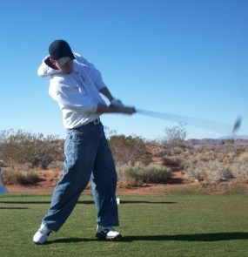
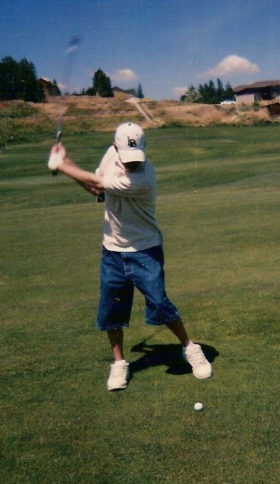
GOLF Anyone?
FORE!
By: Eric Curtis

Slide 2
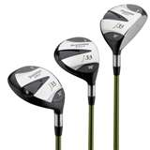
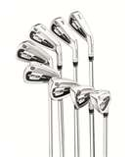
Golfing Equipment
Clothing – weather permitting dress for the temperature Glove and golf shoes.
Clubs – 14 club limit. Includes woods, irons, wedges and putter in your golf bag.
Etc. – towel, covers, balls, tees.

Slide 3
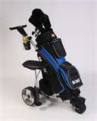
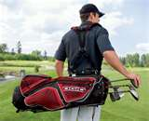
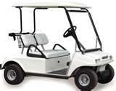
Carrying methods
Caddie
Walk – One or two straps
Pull or Push Cart
Drive cart

Slide 4
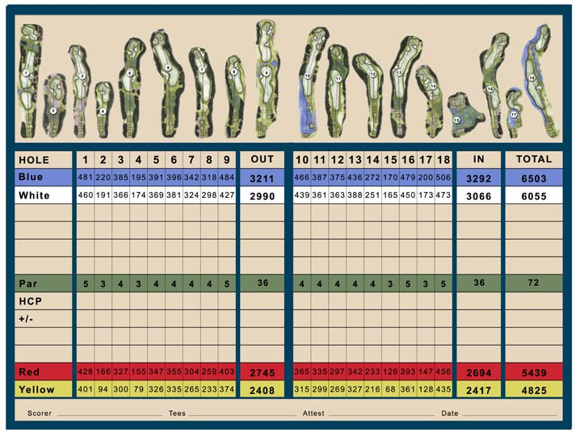
Golf Terminology
“Fore” – Beware before
Stroke - Making contact with ball after swing
Par – Amount of strokes an experienced golfer would get
Birdie – One stroke under par
Eagle – Two strokes under par
Handicap – Amount of strokes added up at the end of round compared to par

Slide 5


GOLF BENEFITS
✦ Health – Endurance, muscle tone and loose weight
✦ Social – Great with friends, meet new people
✦ Stress reliever
✦ Scenic views

