Slide 1
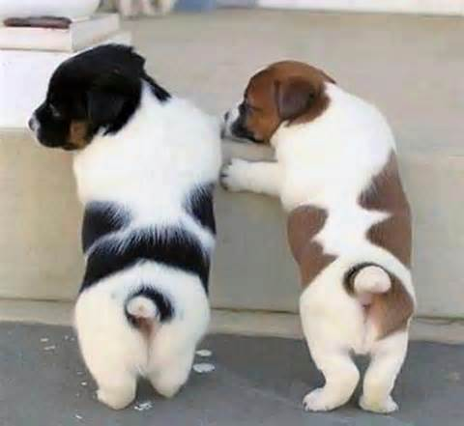

I LIKE BIG MUTTS!
Notes:
*Click on Paw print to play music of the instrumental version of “baby got back” (I like big butts) by Sir mix-a-lot* Beginning of commercial offering a catchy slogan to catch the eye of the audience or any animal lover. - The song is throughout the commercial – (3 Seconds)

Slide 2
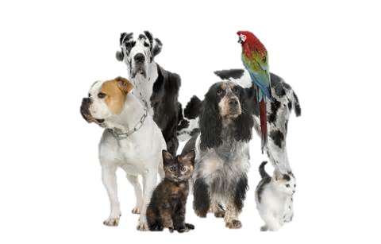
5 million Companion Animals enter animal shelters all over the nation
Notes:
- Silence – (3 Seconds)

Slide 3

3.5 Million companion animals are Euthanized in these animal shelters
Notes:
- Silence – (3 Seconds)

Slide 4
Stats are from 2012
Notes:
Attention all animal lovers! And those who have a heart. (3 Seconds)

Slide 5

BENEFITS OF ADOPTION
You save the life of an innocent animal.
Most shelters spay and neuter their animals.
Most shelters microchip their animals.
Notes:
Narrator: “By choosing adoption as the loving option, you help us reduce pet overpopulation so fewer cats and dogs suffer in the future. There are many health benefits related to having a pet; owners are less likely to suffer from depression. Pet owners also are likely to have lower blood pressure. Playing with a pet can elevate levels of serotonin and dopamine, which can calm and relax. ” (8 Seconds)

Slide 6
Animal Shelters Near You!
Salt Lake County Animal Services:
511 W. 3900 S. Salt Lake City, UT
Utah County Animal Shelters:
North Division - 193 N. 200 W. Lindon, UT
South Division - 582 W. 3000 N. Spanish Fork, UT
Weber County Animal Shelter:
1373 No. 750 W. Ogden, UT
Notes:
Narrator: “Please see the nearest animals shelter and adopt your newest family member and remember; adoption is the loving option! – Silence – (4 seconds)

Slide 7

On the Web
Humane Society of Utah:
www.utahhumane.org
Best Friends Animal Society:
www.bestfriends.org
Notes:
Narrator: Also visit these websites for more information at www.utahhumane.org or www.bestfriends.org (3 seconds)

Slide 8
Work cited:
Robinson, Lawrence, Segal, Jeanne. “The Therapeutic Benefits of Pets.” Helpguide.org, June 2013. Web. 23 July 2013.
Humane Society of the United States. “Benefits of Adopting a Pet.” kyhumane.org. Kentucky Humane Society, 2012. Web. 23 July 2013.
American Humane Society. statisticbrain. 22 August 2012. 23 July 2013. <http://www.statisticbrain.com/animal-shelter-statistics/>.
Notes:
(2 Seconds)

Slide 9
PSA Brought To You By:
Project Group #2
Notes:
(2 second)

